Slide 1
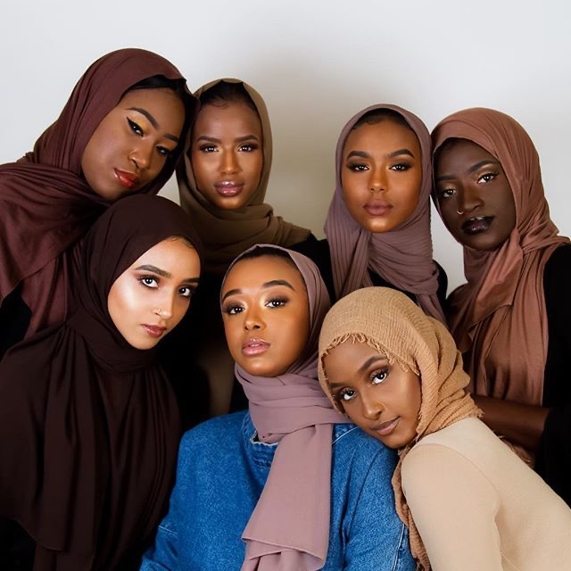
BIAS DETECTION IN TWEETS TOWARDS HIJAB IN FRANCE VS IRAN
Muhammad Hamzah

Slide 2
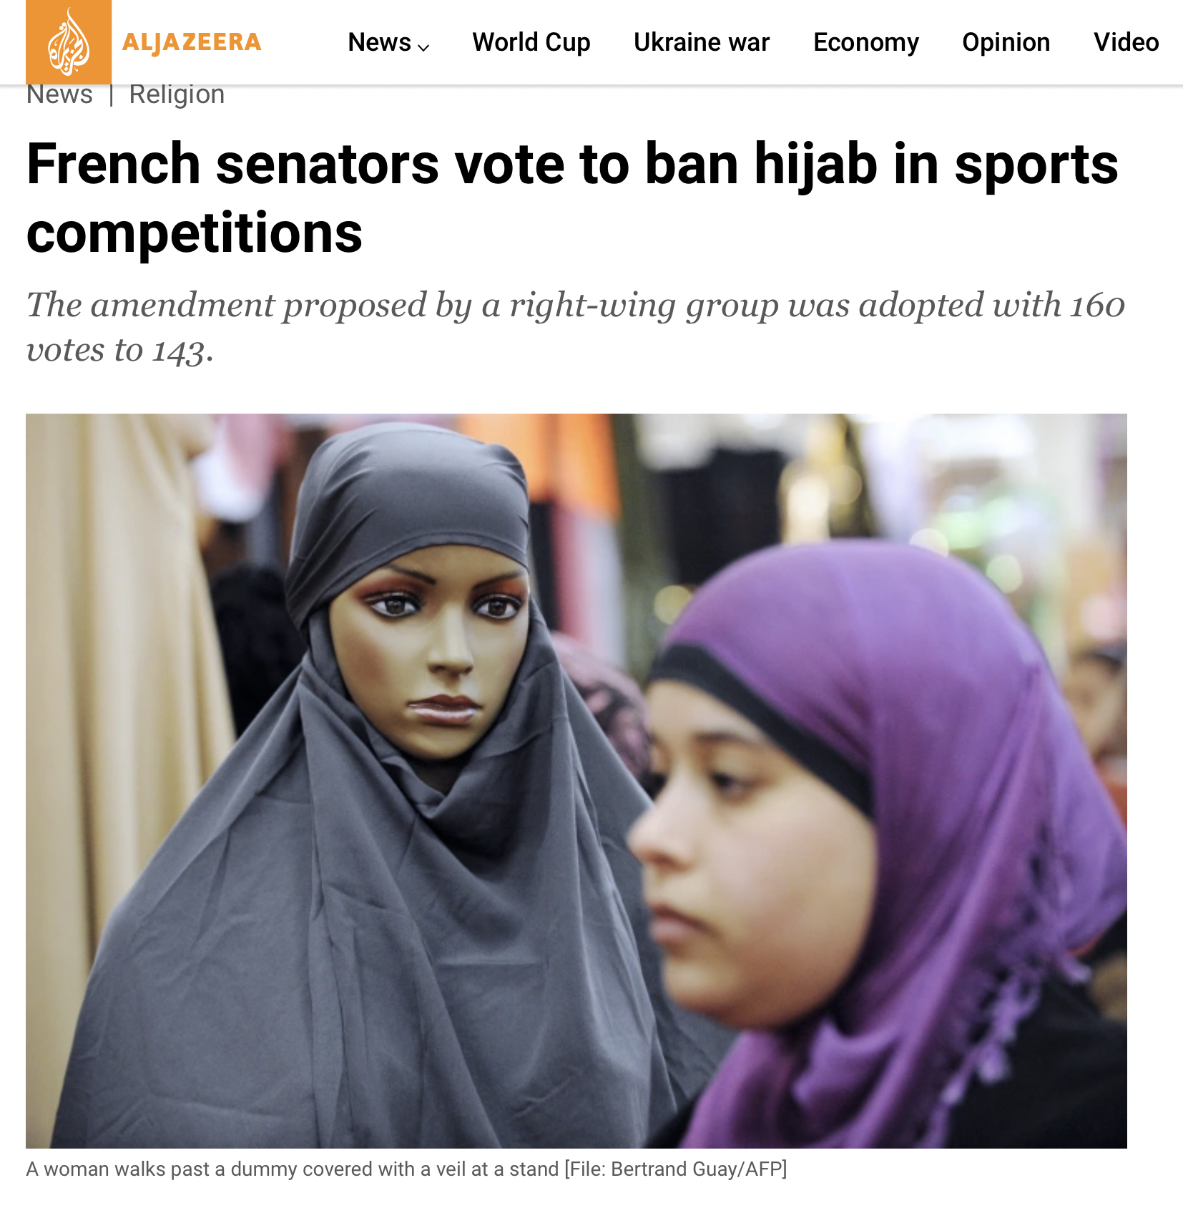
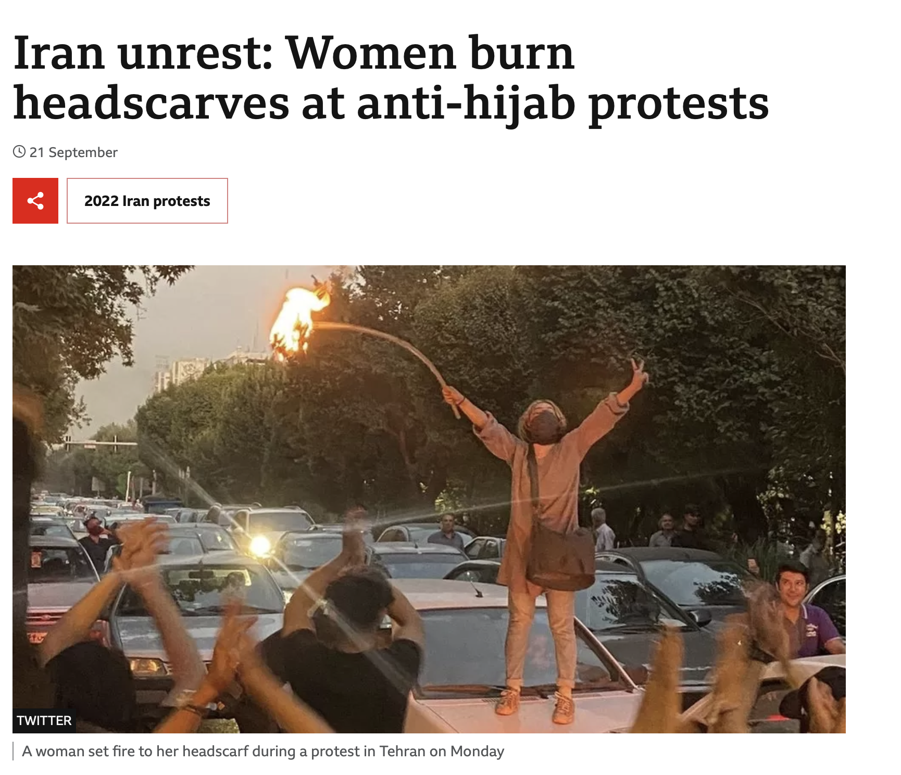
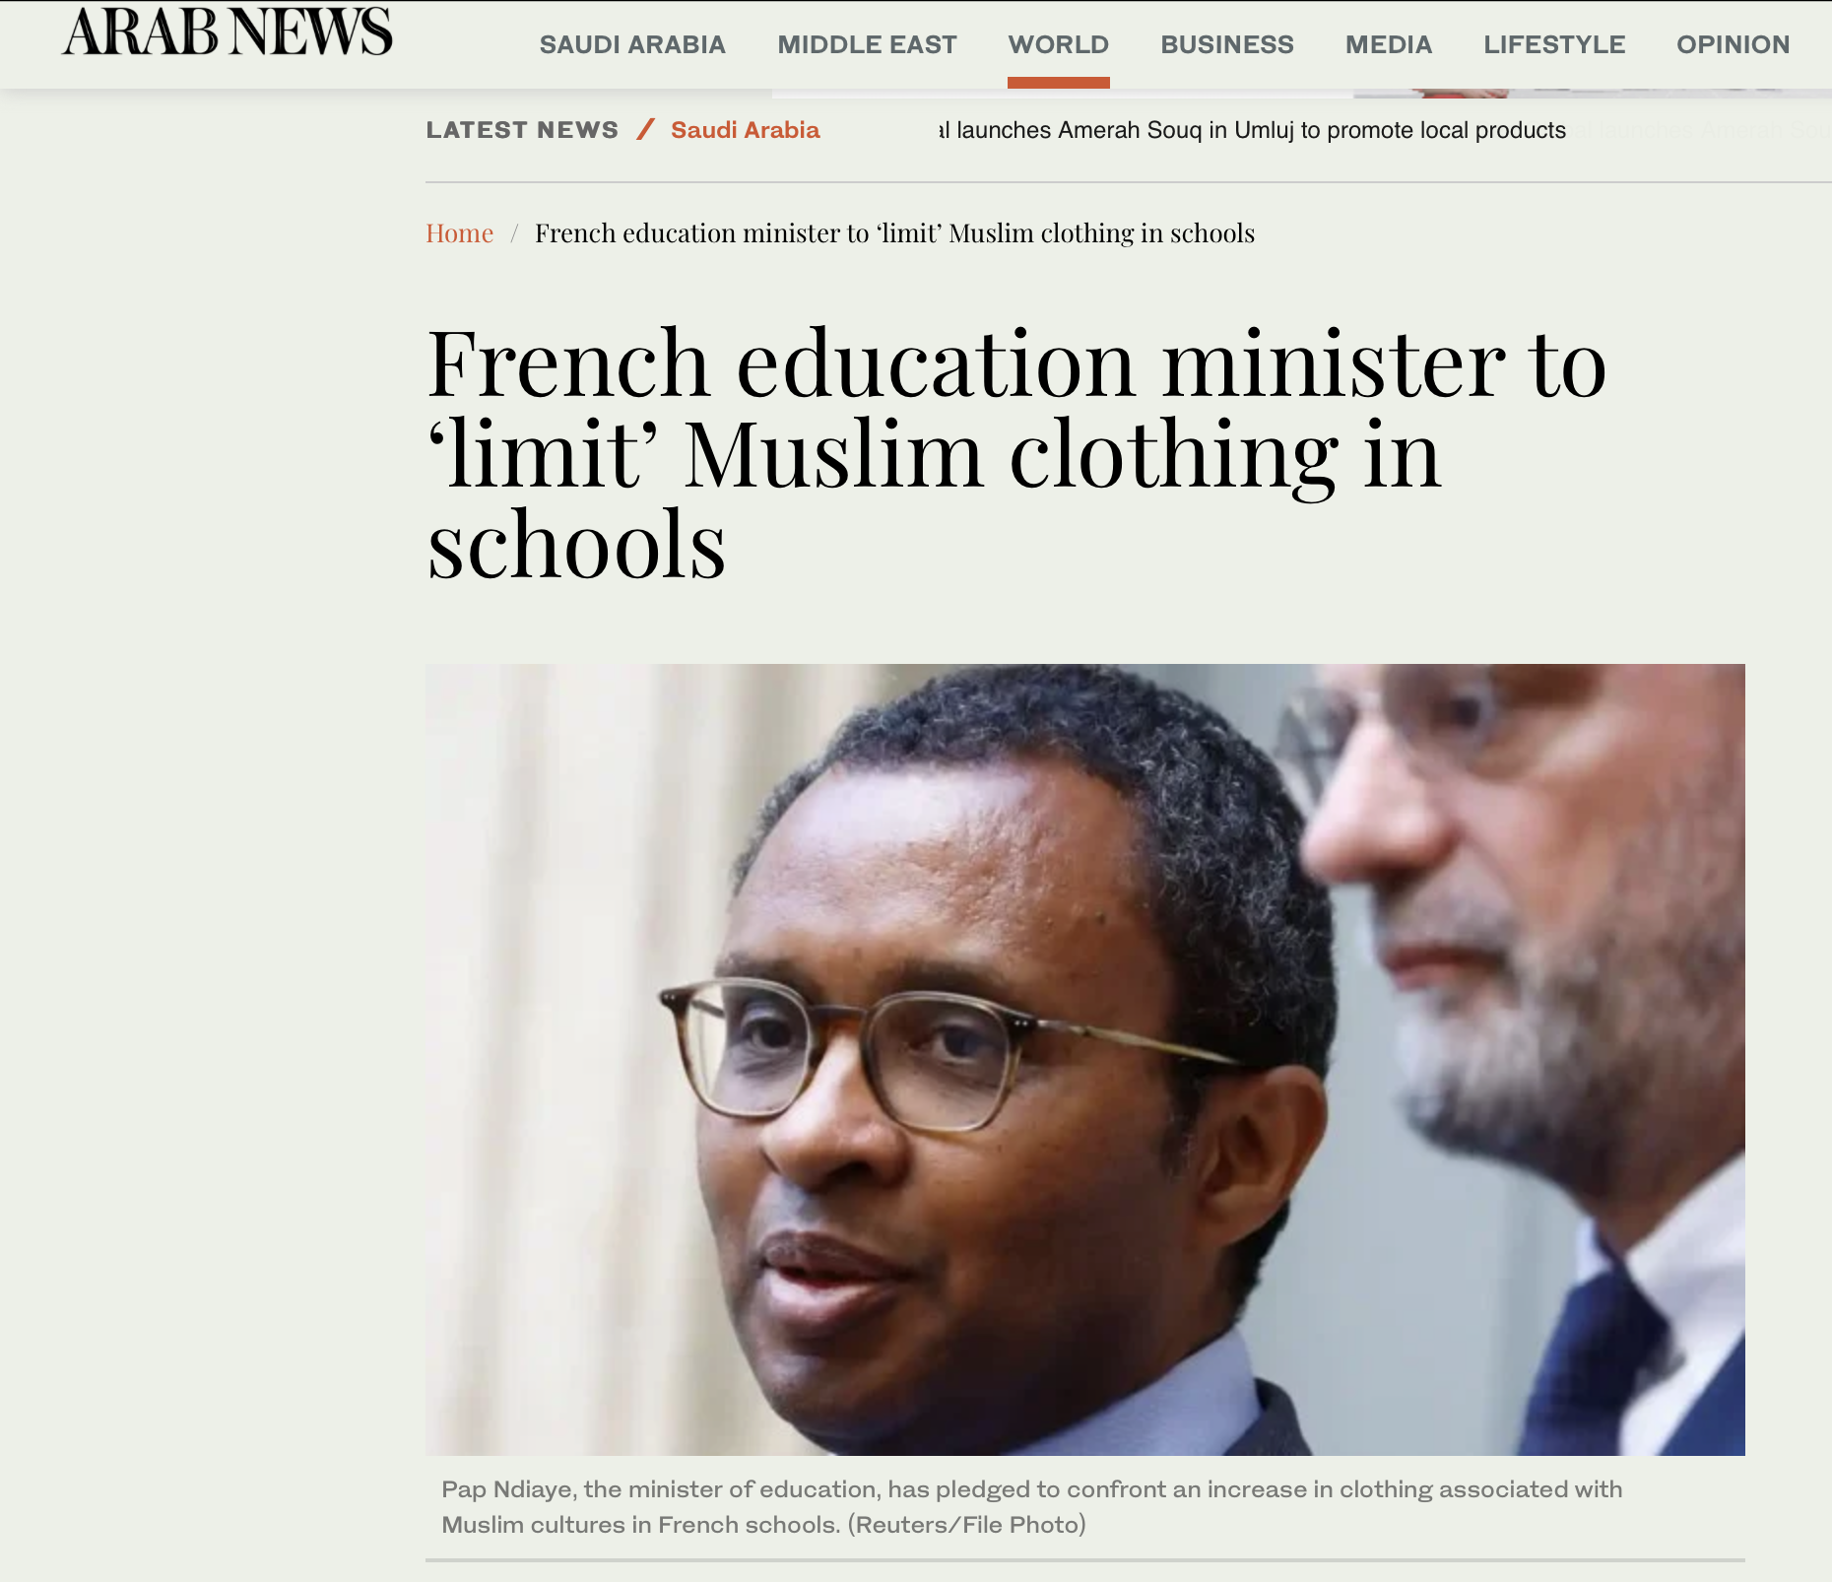
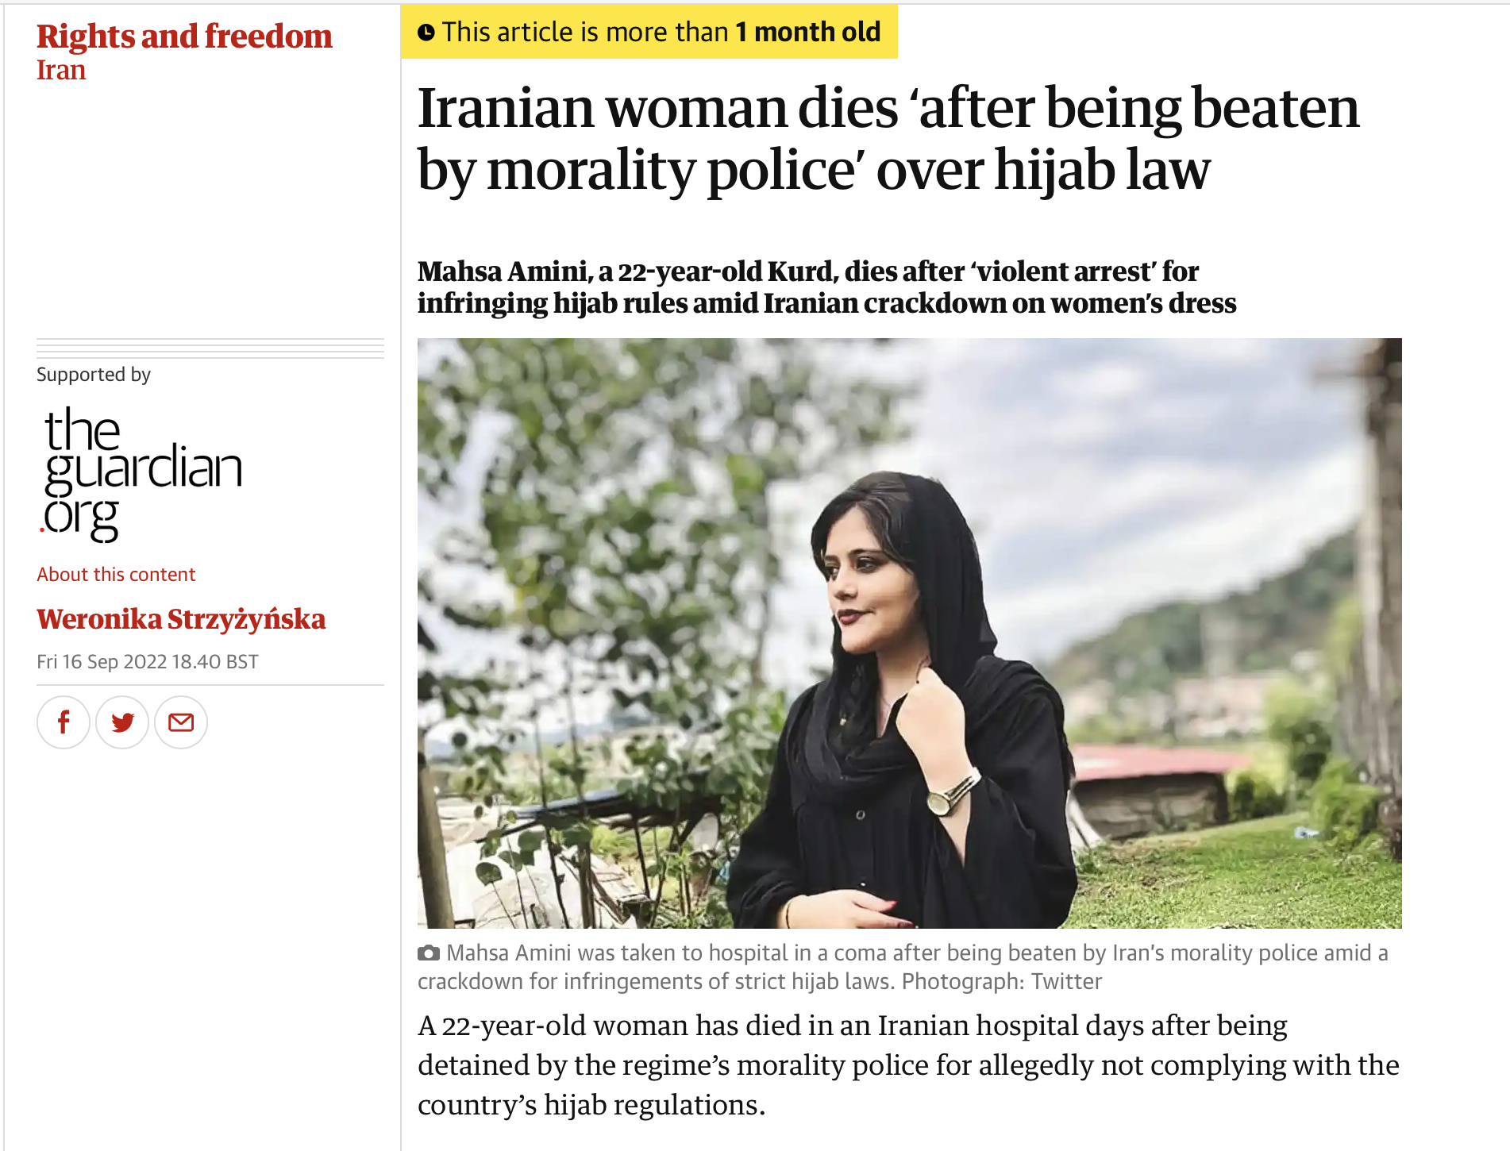
Inspiration and choice of topic
Analysis of people’s opinions
Detection of biased news
Compare the tweets from countries with the opposite views

Slide 3
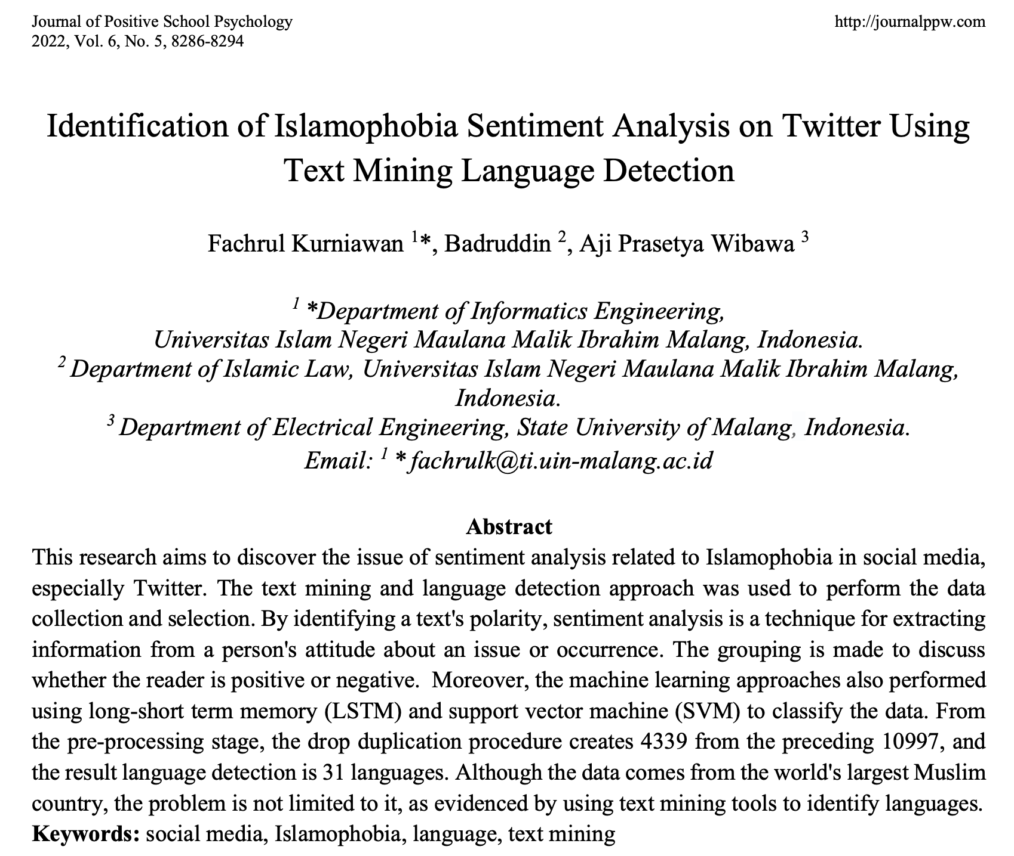
Related works
Kurniawan et al.
LSTM and SVM classifiers
73.797% for LSTM and 60.22% for SVM
Data from islamophobic hashtag in Twitter
Tweepy for data scraping

Slide 4
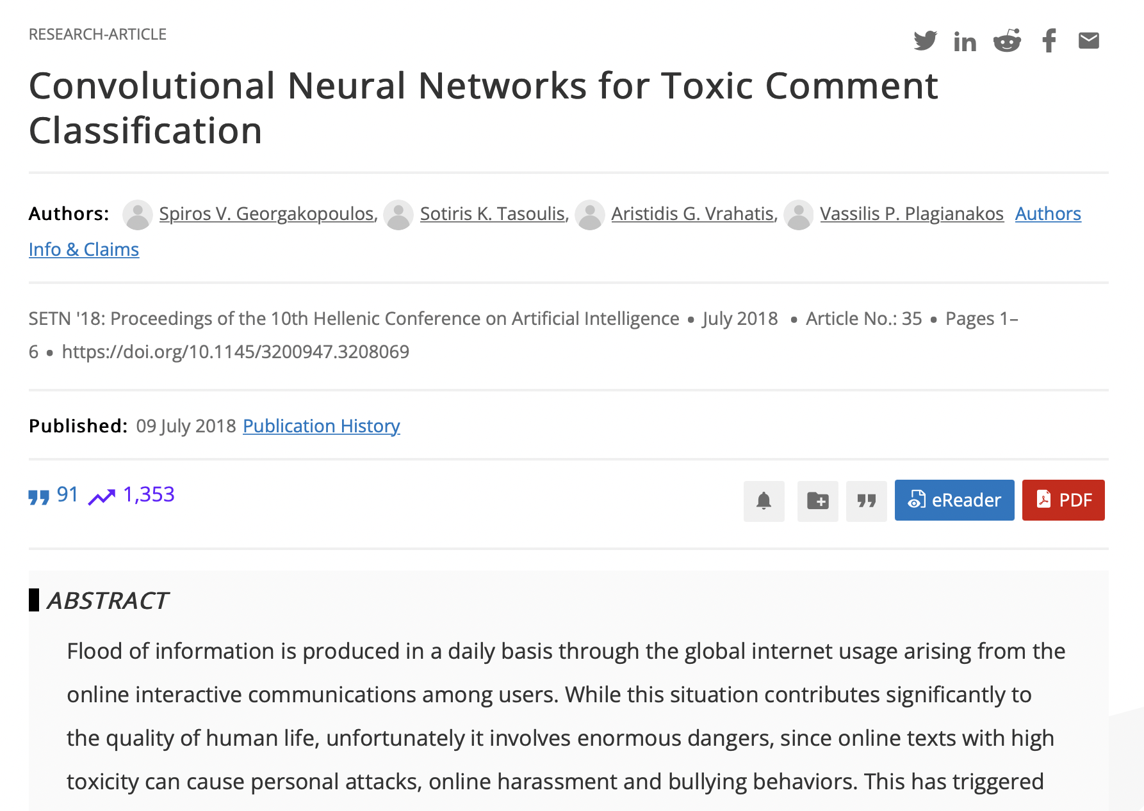
Related works
Georgakopoulos et al.
CNNs for classification
Better than Bag-of-words approaches
Kaggle dataset for Wikipedia talk page edits

Slide 5
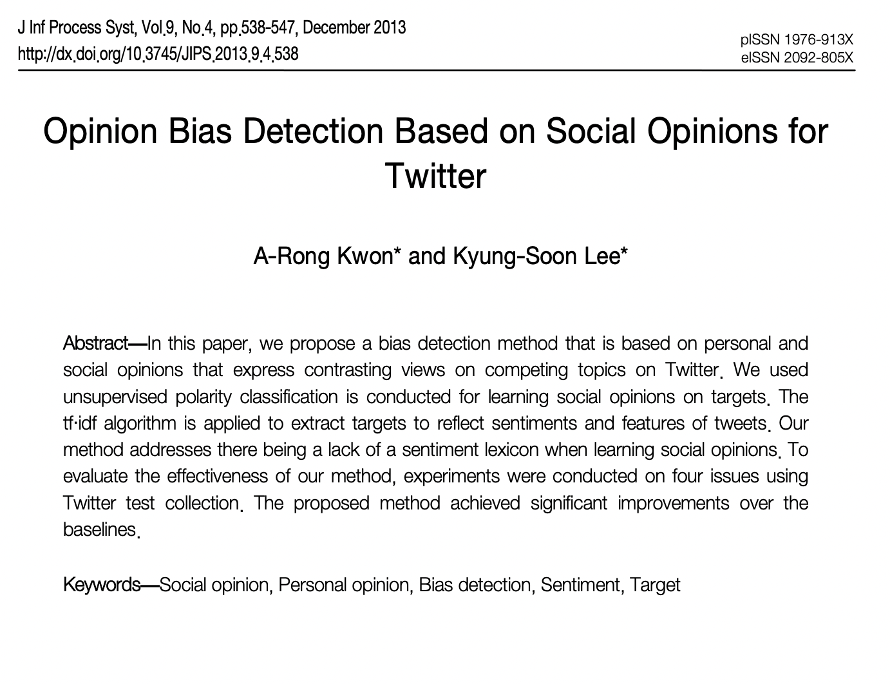
Related works
Kwon et al.
unsupervised polarity classification
TF-IDF representation
Tweets on competing topics
(e.g. Mac vs Windows)

Slide 6
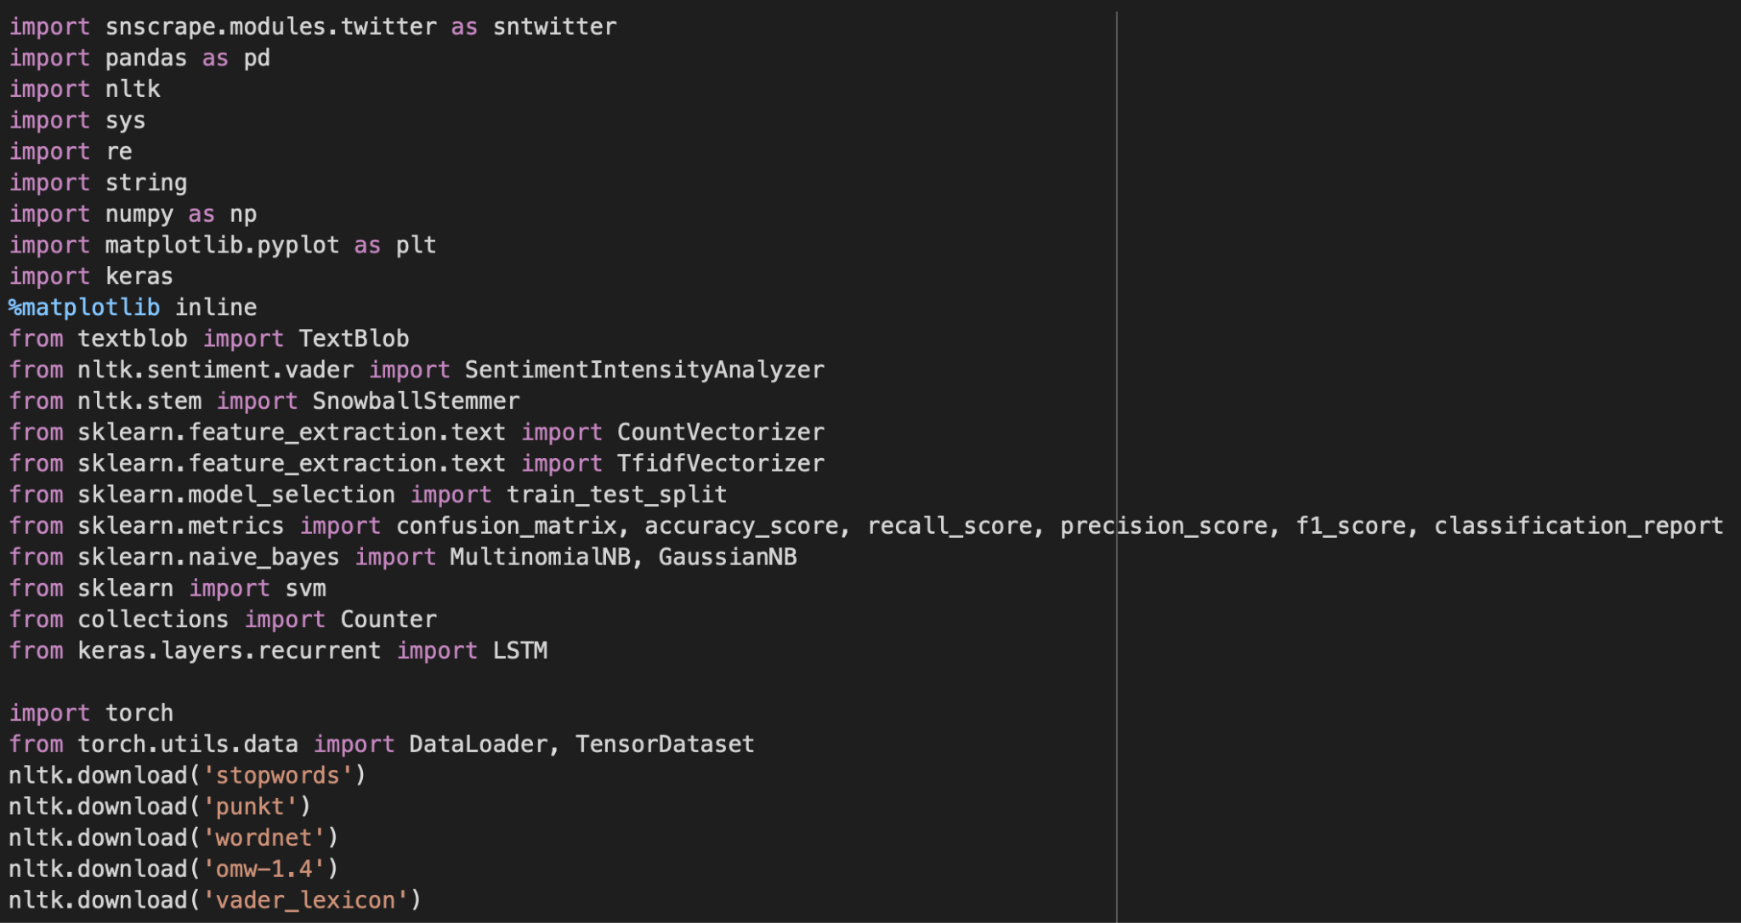
Tools & libraries used

Slide 7
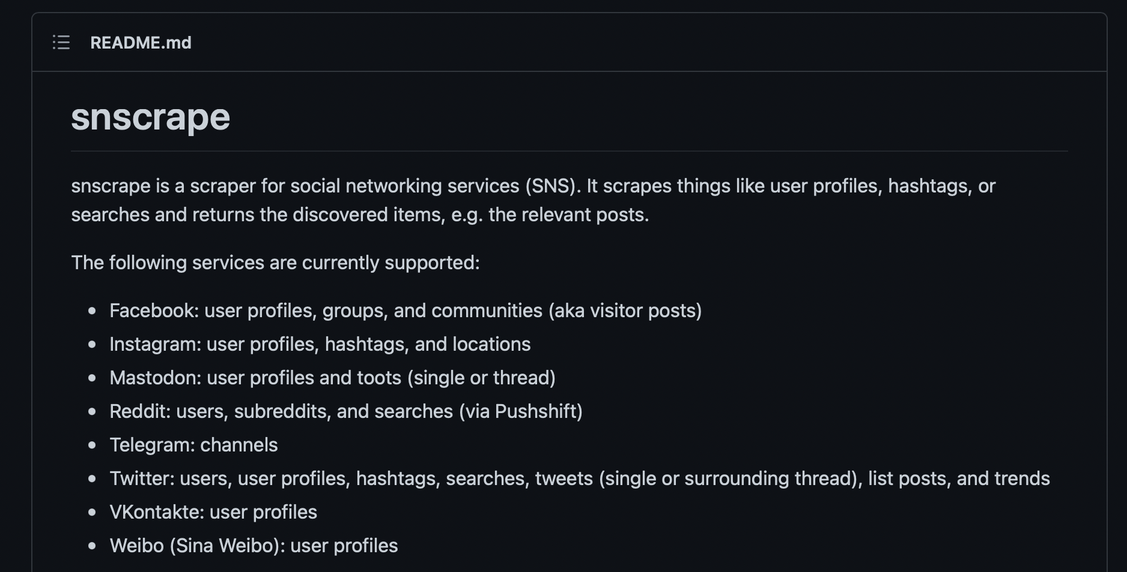

Data collection
Snscrape tool
Filter based on keywords (e.g. #hijab)
Location filter
Time period filter (2011/2021-2022)
Date, ID, content, username
50000 tweets limit

Slide 8
Data collection
Snscrape tool Queries

Slide 9
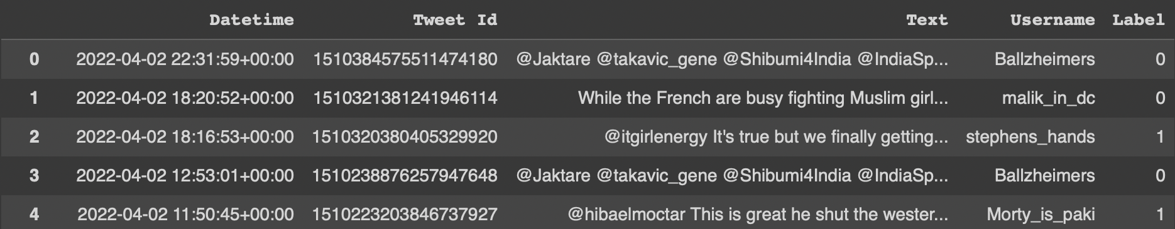
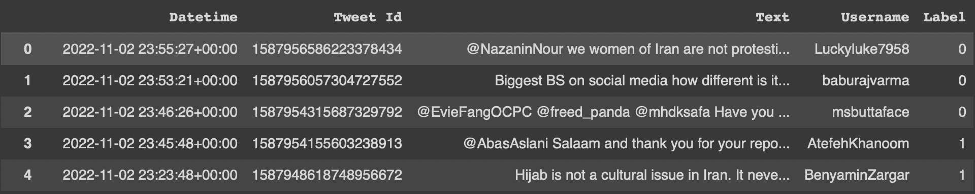
Data Processing
Pandas dataframes - export into CSV
Save time on scraping ~1 hour each
Labeling as negative/neutral/positive

Slide 10
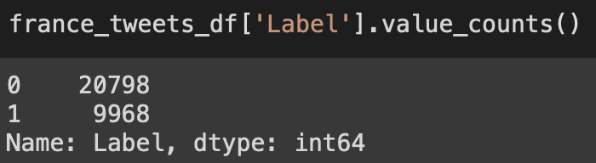
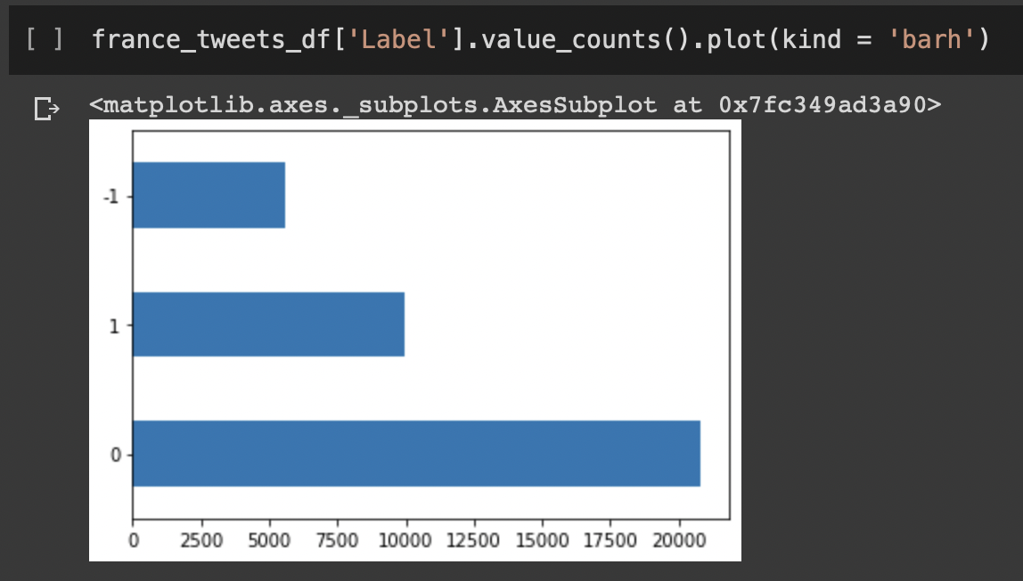
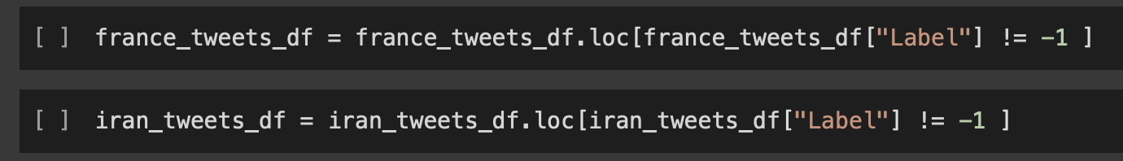
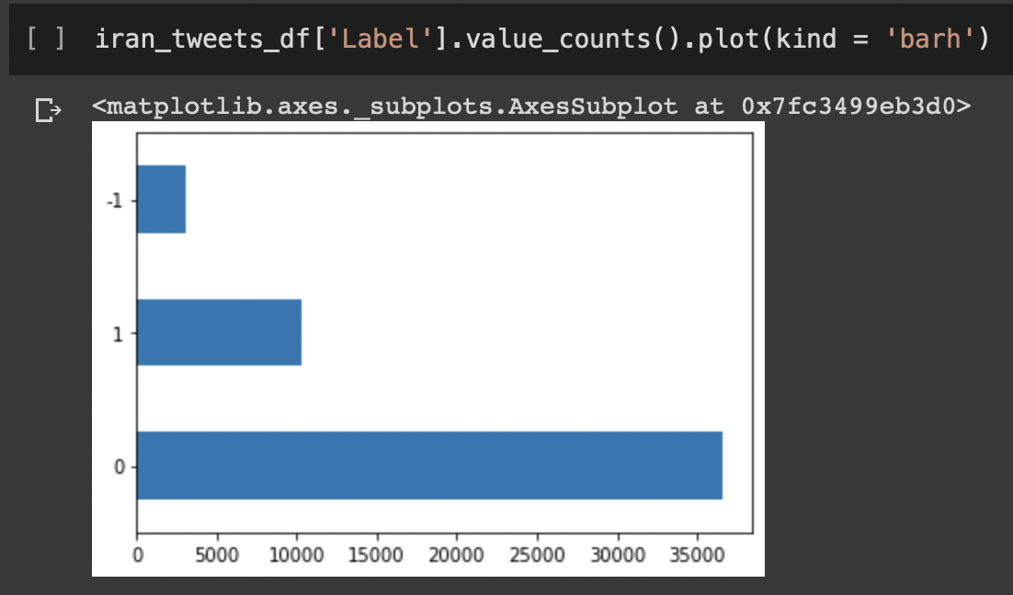
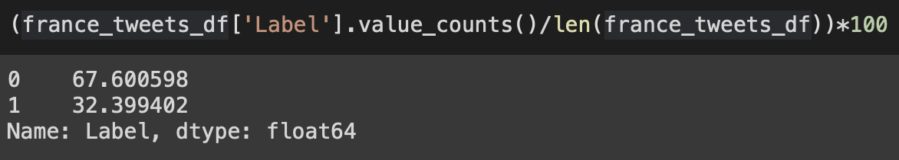
Data Processing
Removal of neutral tweets
Notes:
Approximately 48% of positive to negative tweets rate in both countries

Slide 11
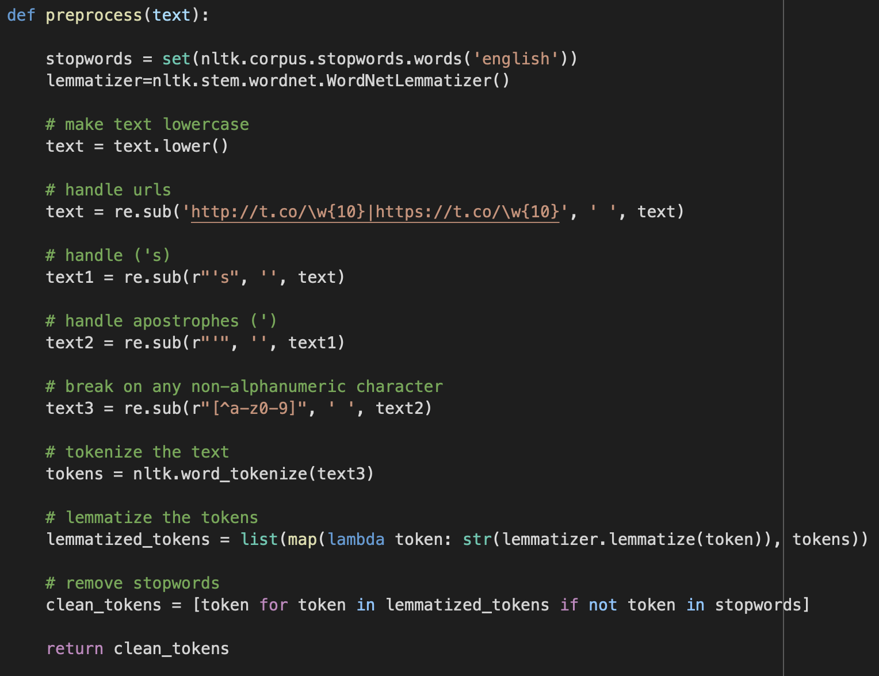
Text pre-Processing
Lowercase
Punctuation removal
URL removal
Stopwords removal
Lemmatization
Tokenization

Slide 12
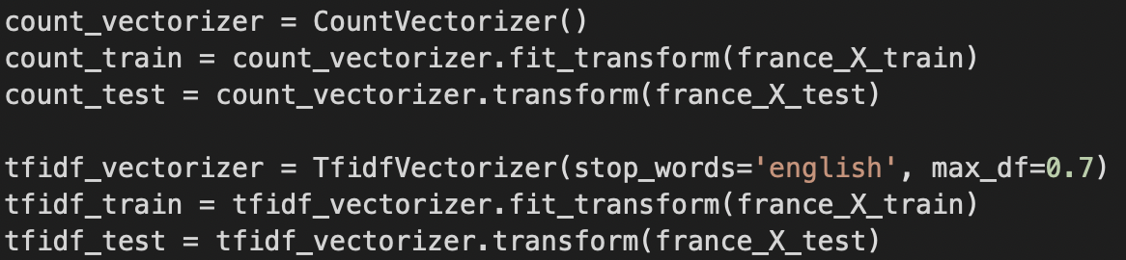
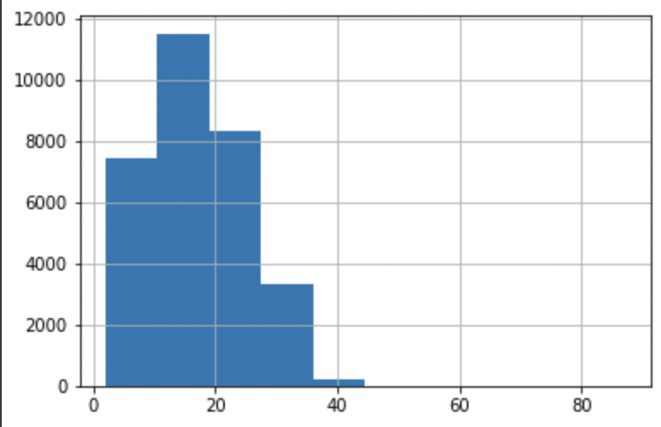
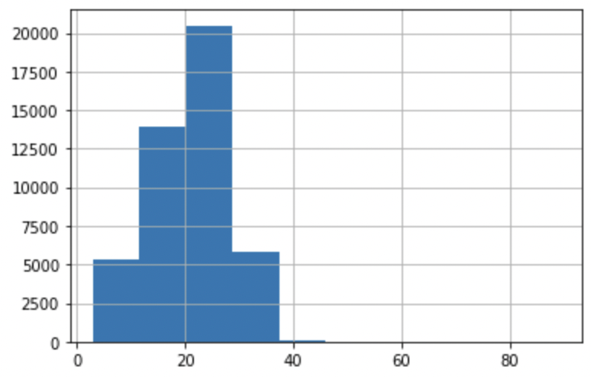
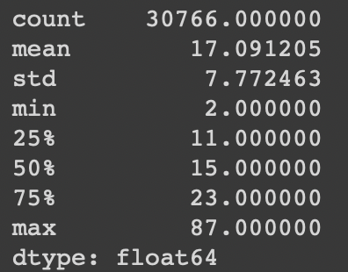
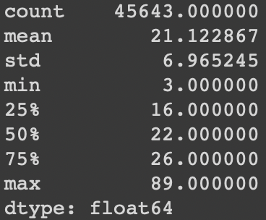
Feature engineering
Count vectorizer
TF-IDF Computation
Data loaders
Tweet length

Slide 13
Feature Engineering
Most common words
Notes:
Approximately 48% of positive to negative tweets rate in both countries

Slide 14
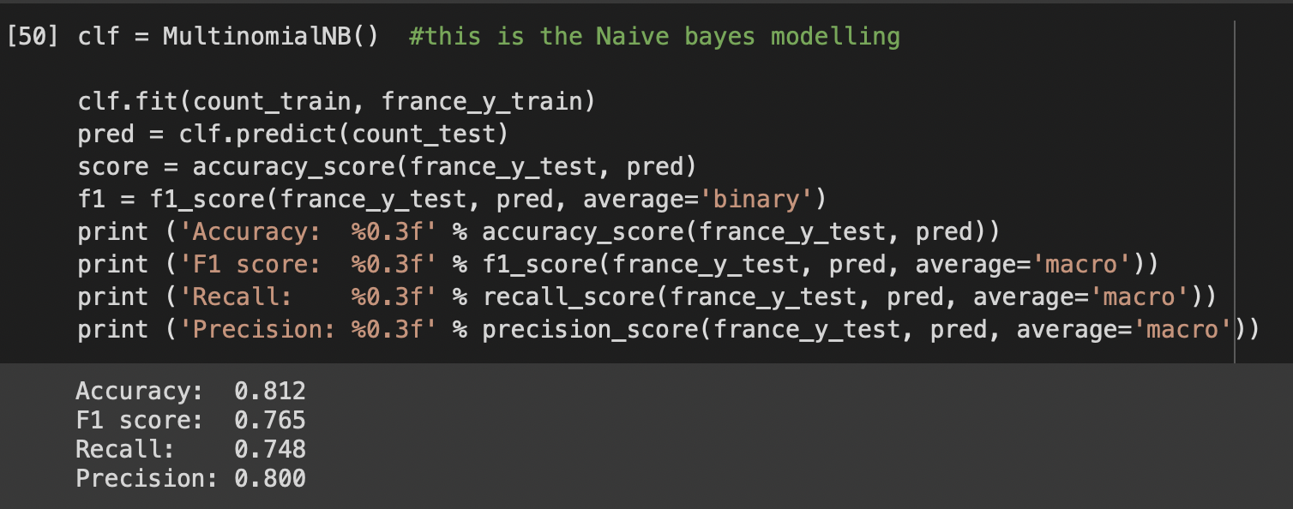
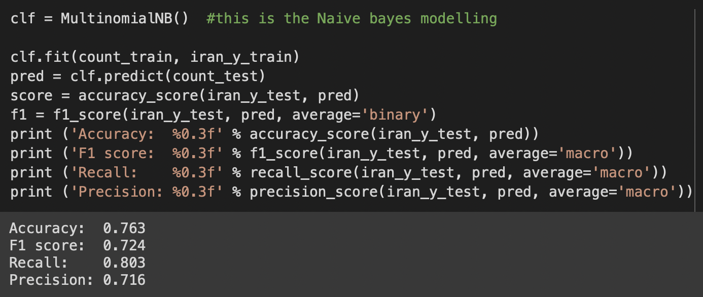
Choice of models
Baseline: Multinomial Naive-Bayes model

Slide 15
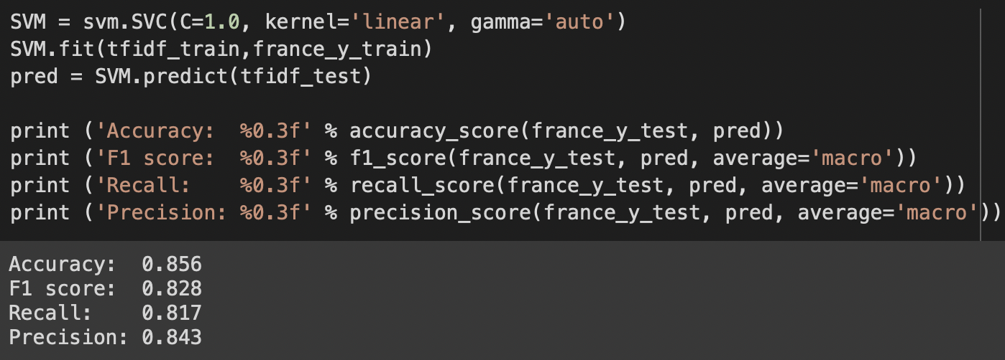
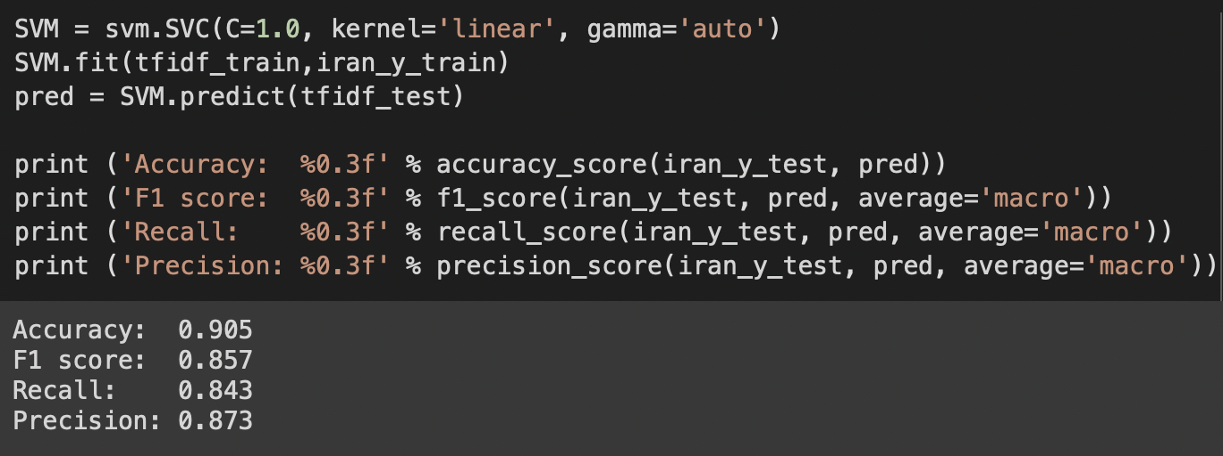
Choice of models
Support Vector Machine (SVM) Classifier

Slide 16
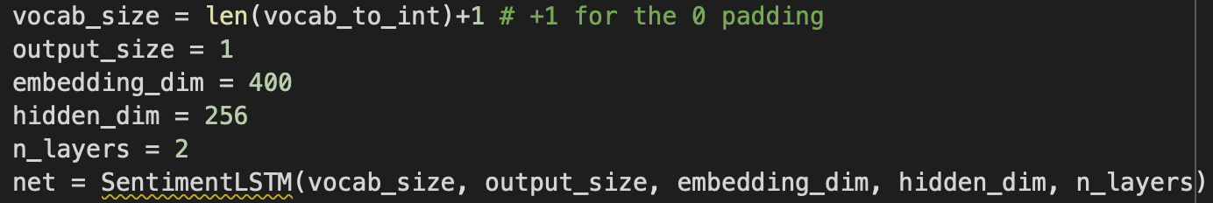
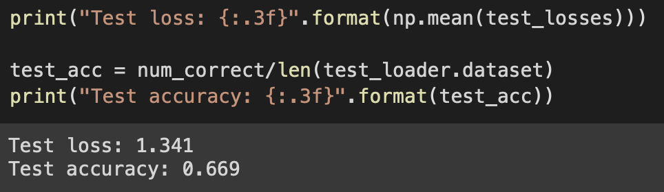
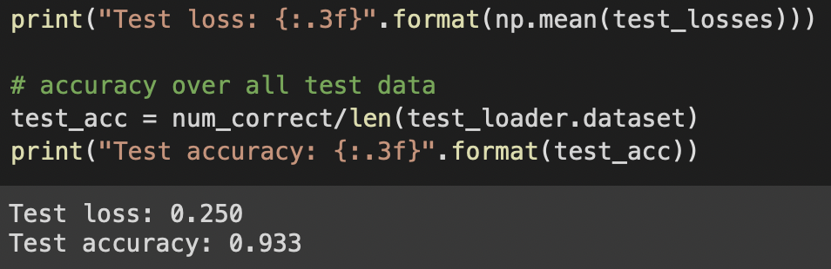
Choice of models
Long Short Term Memory (LSTM) Classifier

Slide 17
Conclusion: Models
SVM classifier - better accuracy for both countries

Slide 18
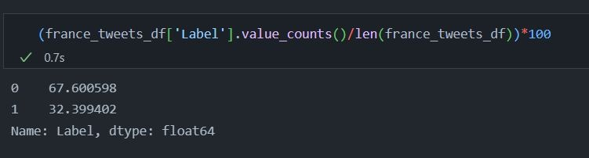
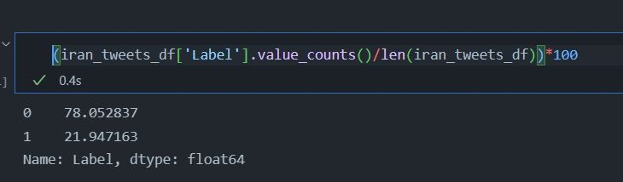
Conclusion: ABout data?

Slide 19
Resources
News:
https://www.arabnews.com/node/2181111/world
https://www.theguardian.com/global-development/2022/sep/16/iranian-woman-dies-after-being-beaten-by-morality-police-over-hijab-law
https://www.bbc.com/news/world-middle-east-62967381
http://koreascience.or.kr/article/JAKO201301671902626.pdf
Identification of Islamophobia Sentiment Analysis on Twitter ...https://journalppw.com › jpsp › article › download

